Slide 1
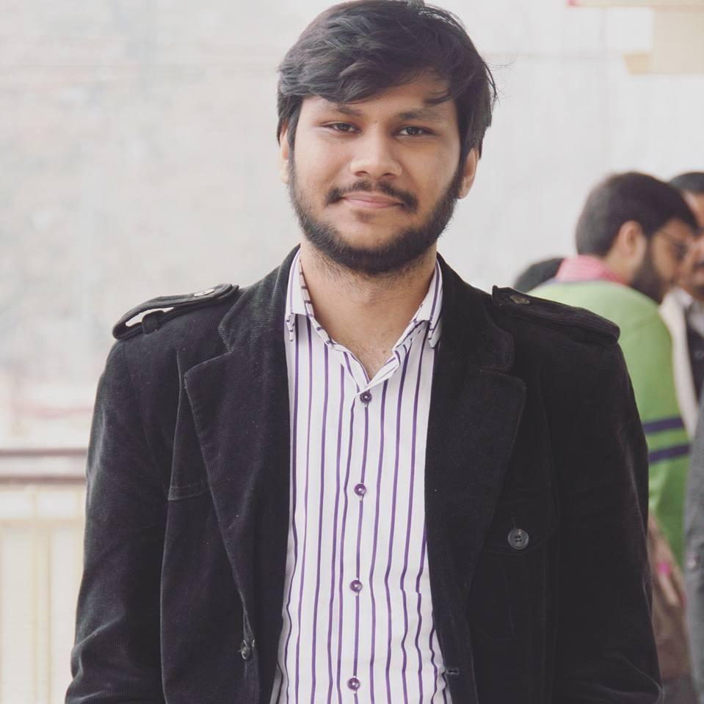
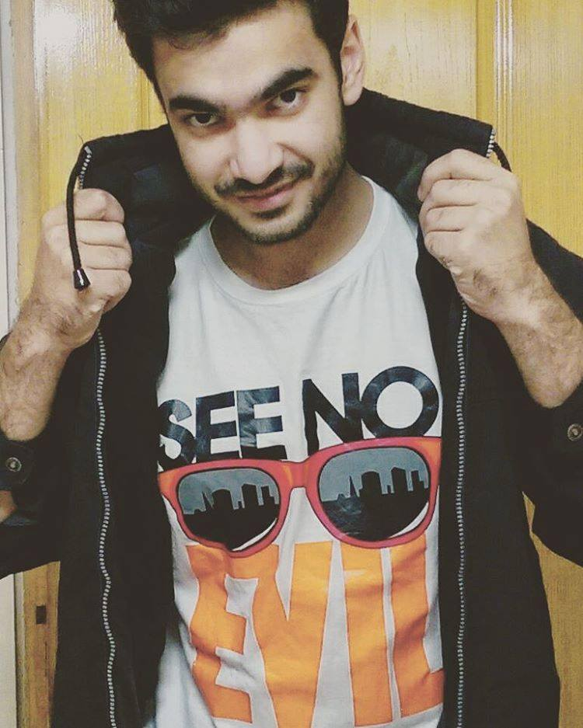

Pakistan Gaming Network (PGN)
The team
Abdul Jalil Mian (BSCS-13062)
Shehryar Raza (BSCS-13020)
Mariyah Kaleem (BSCS-13065)

Slide 2
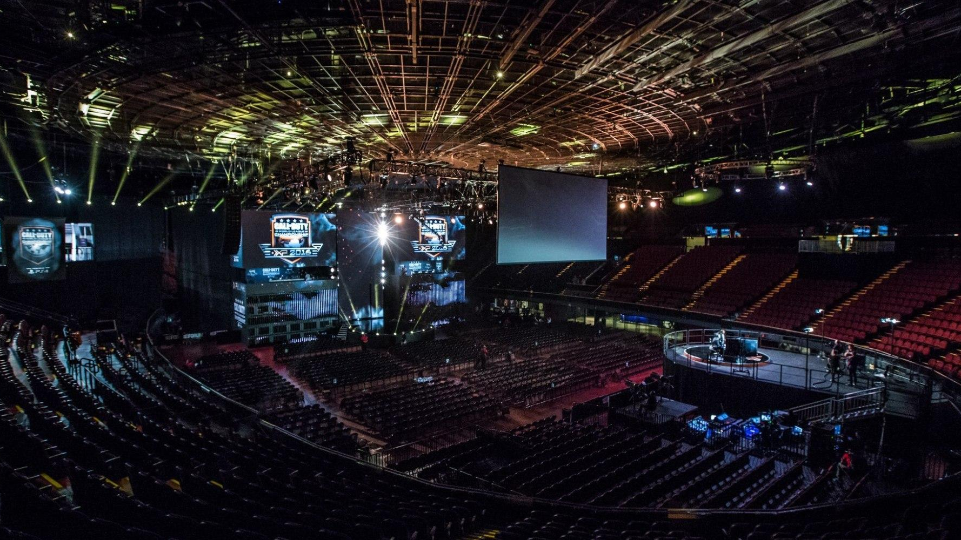
Value Proposition
“Find gamers around you”

Slide 3
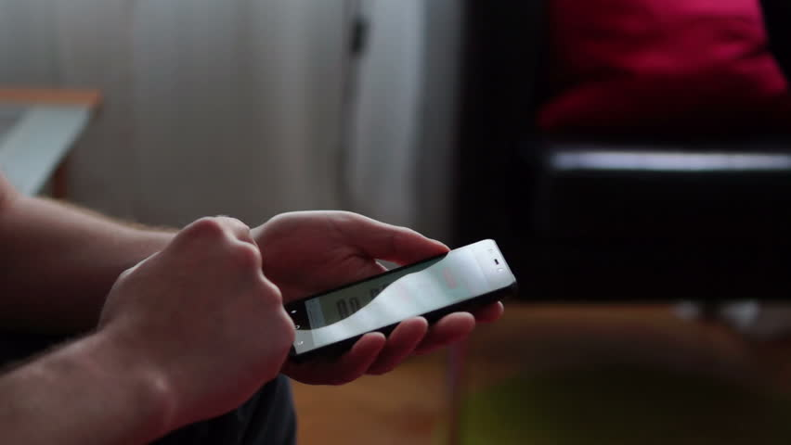
Problem Overview
There is no proper platform in Pakistan to notify gamers about the upcoming tournaments or gamers’ meetup.

Slide 4

The solution
Our app is specially designed to tackle the problems mentioned by sending location based notifications to the users about the events or gamers’ meetups.

Slide 5
Tasks
Simple: Find upcoming events
Medium: Find players nearby and interact with other users
Complex: Create events and meetups

Slide 6
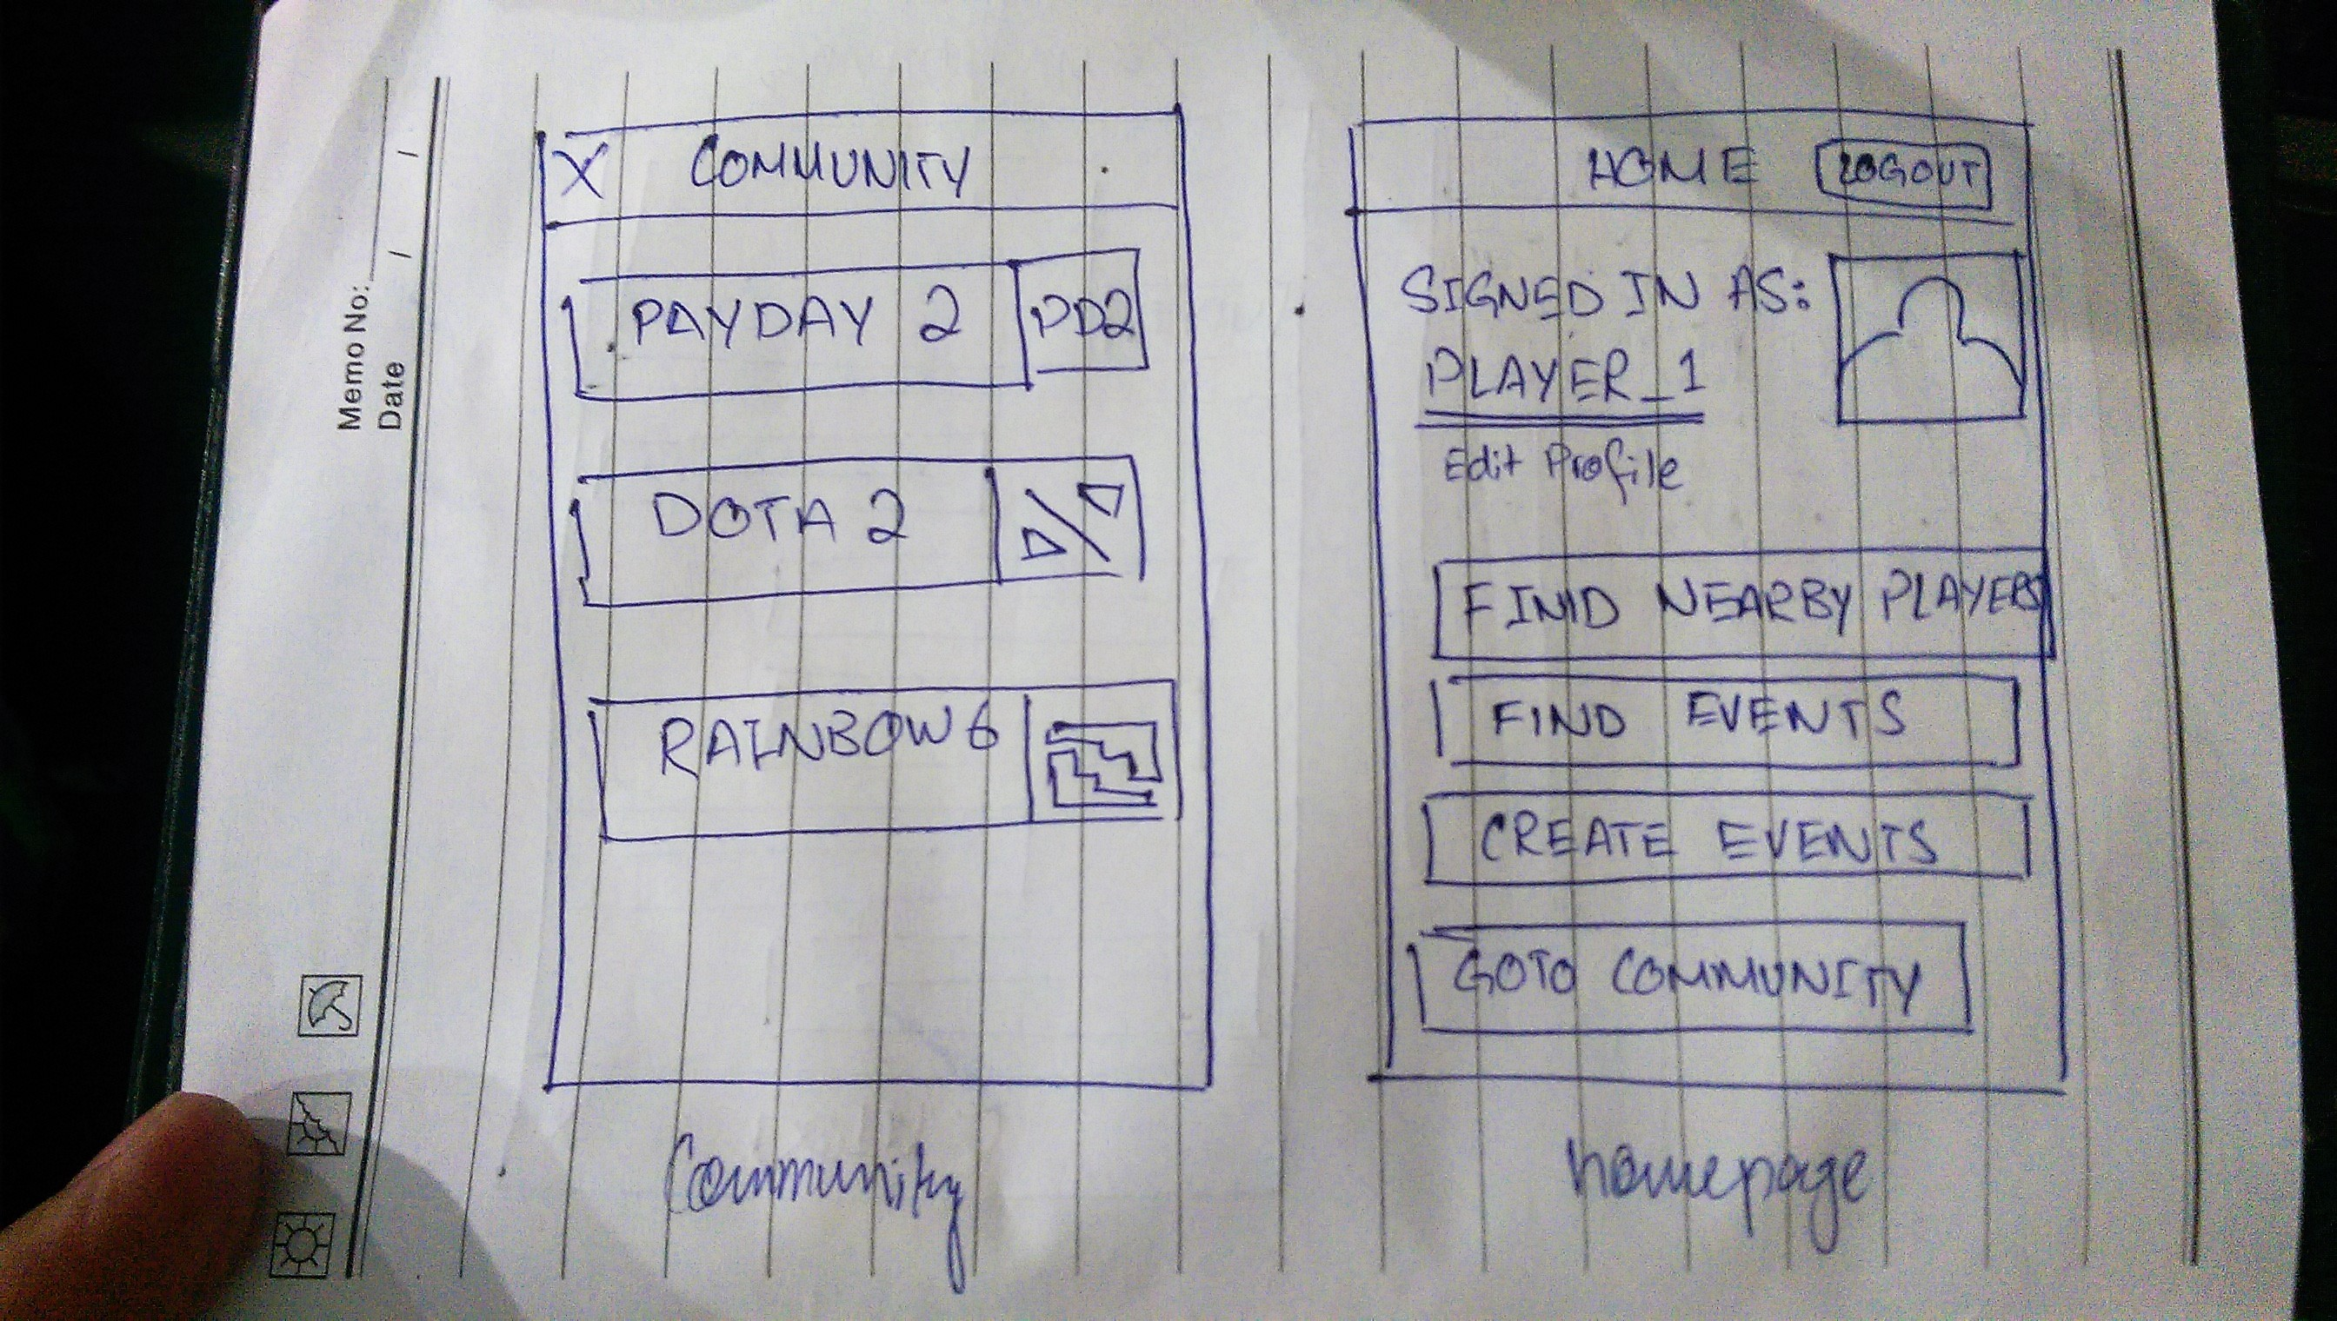
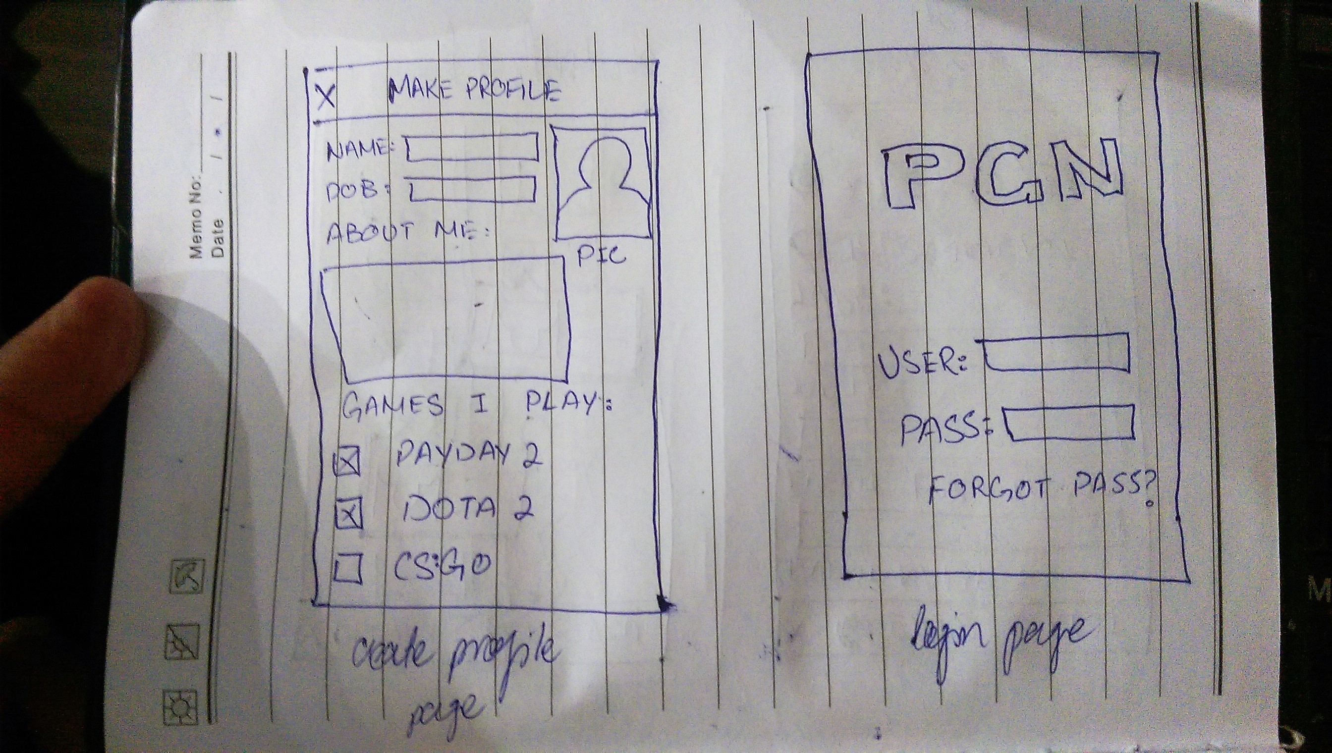
Storyboard

Slide 7
Storyboard (cont.)

Slide 8
YouTube Link
https://youtu.be/M8IStPC_Cug

